Slide 1


Mobile Phone Security
Dr. Digvijaysinh Rathod
Associate Professor
(Cyber Security and Digital Forensics)
Institute of Forensic Science
Gujarat Forensic Sciences University
digvijay.rathod@gfsu.edu.in

Slide 2
  Practical related
  to
  Android Start-up Process with ADB
Dr. Digvijaysinh Rathod

Slide 3
Android boot process
  The sequence of steps involved in Android boot process is as follows:
  1. Boot ROM code execution
  2. The boot loader
  3. The Linux kernel
  4. The init process
  5. Zygote and Dalvik
  6. The system server
Dr. Digvijaysinh Rathod

Slide 4
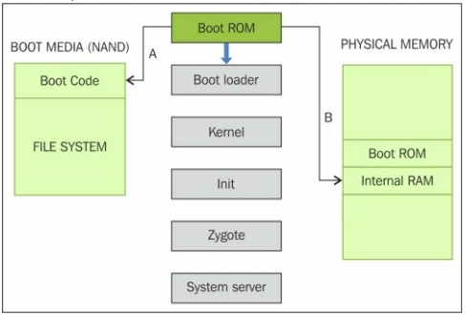
Android boot process
Dr. Digvijaysinh Rathod

Slide 5
Android boot process – The init process
  The init is the very first process that starts and is the root process of all other processes - (init.rc).
  The init process will parse the init.rc script and launch the system service processes.
  At this stage, you will see the Android logo on the device screen.
Dr. Digvijaysinh Rathod

Slide 6
Android boot process – Zygote and Dalvik
  Zygote is one of the first init processes created after the device boots.
  It initializes the Dalvik virtual machine and tries to create multiple instances to support each android process.
  Zygote facilitates using a shared code across the VM, thus helping to save the memory and reduce the burden on the system.
Dr. Digvijaysinh Rathod

Slide 7
Mobile Phone Security
Dr. Digvijaysinh Rathod
Associate Professor
(Cyber Security and Digital Forensics)
Institute of Forensic Science
Gujarat Forensic Sciences University
digvijay.rathod@gfsu.edu.in

